Slide 1

Capstone Final Project: Plume Analysis
Justin Tice & Megan Hoeksema
March 1, 2023

Slide 2
Background

Slide 3
Research Questions
Characterize the sensors’ performance and operation. Are they all working properly at all times? Can you detect any unexpected behaviors of the sensors through analyzing the readings they capture?
Now turn your attention to the chemicals themselves. Which chemicals are being detected by the sensor group? What patterns of chemical releases do you see, as being reported in the data?
Which factories are responsible for which chemical releases? Carefully describe how you determined this using all the data you have available. For the factories you identified, describe any observed patterns of operation revealed in the data.

Slide 4
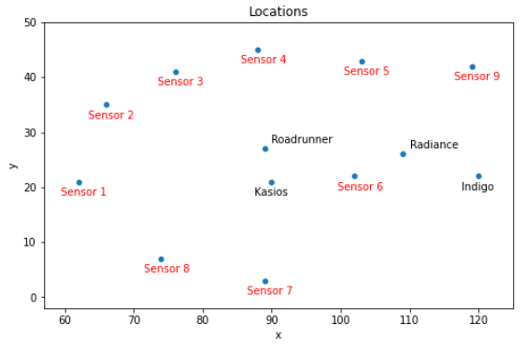
Datasets
Sensor data
3 months (April, August, December), every hour/day/month
9 different sensors
Readings of each chemical in parts per million (ppm)
Meteorological data
Location data
Gives the x, y coordinates for 9 sensors and 4 factories
Calculated the distances between each factory and sensor

Slide 5
Data Preparation
Sensor Data
Rename column titles. The Date Time column has a whitespace at the end.
Convert the date time column to datetime in order to create visualizations.
Set the datetime as the index.
No null values.
Meteorological Data
Location Data
Data was provided in word file.
Pandas DF manually created.

Slide 6
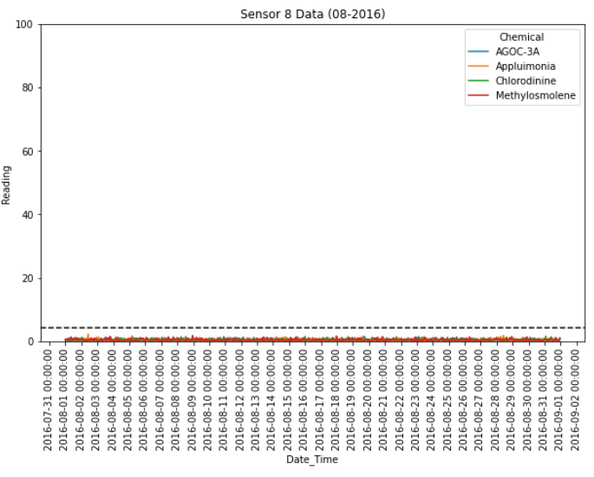
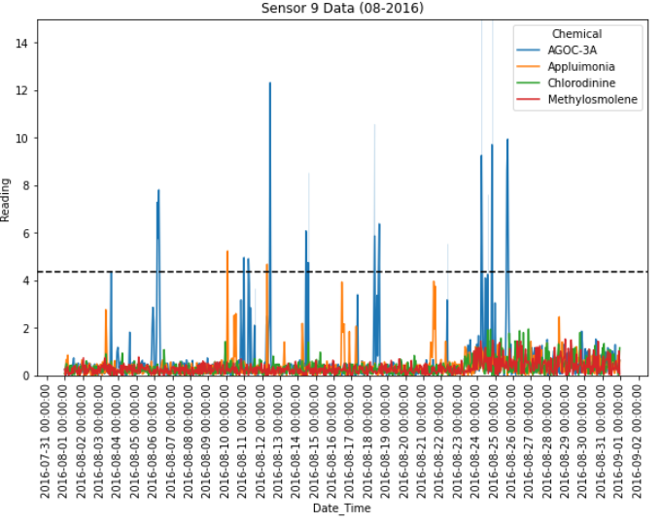
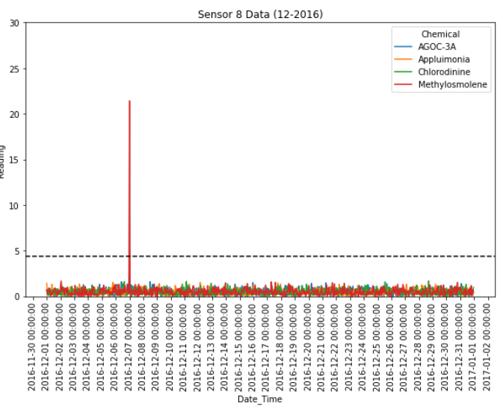
Characterization of the sensors’ performance and operation
Potentially Faulty Sensors/Unexpected Patters in Sensor Behavior
Sensor 8
In April, sensor is picking up 12 significant signals in ¾ chemicals. Going into August, it is only detecting background noise. Then going into December, only 1 spike in Methylosmolene is detected.
Sensor 9
In August, the background noise increases towards the end of the month.

Slide 7
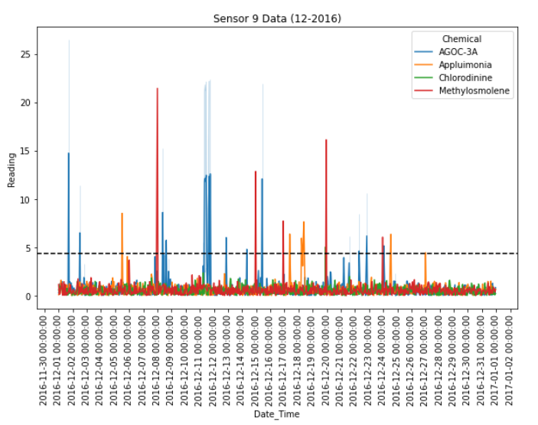
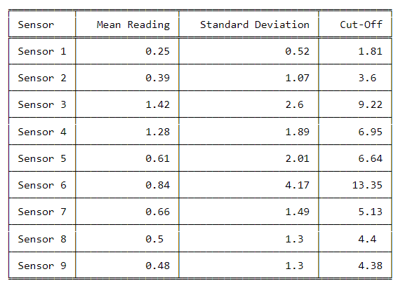
Which chemicals are being detected by the sensor group?
In order to determine if a significant increase is being detected by each sensor, the mean of all readings in the sensor group was calculated, then the cutoff for significance was assigned as the mean + ( 3 * standard deviation).
Significance Cut-Off Calculations

Slide 8
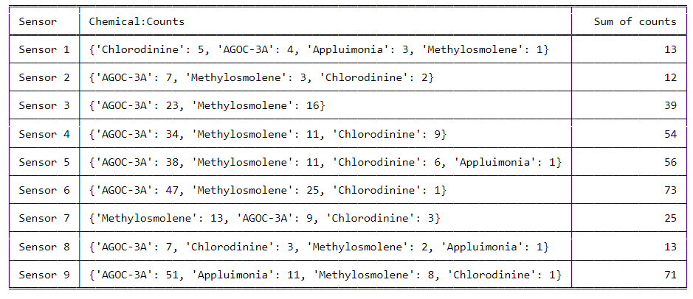
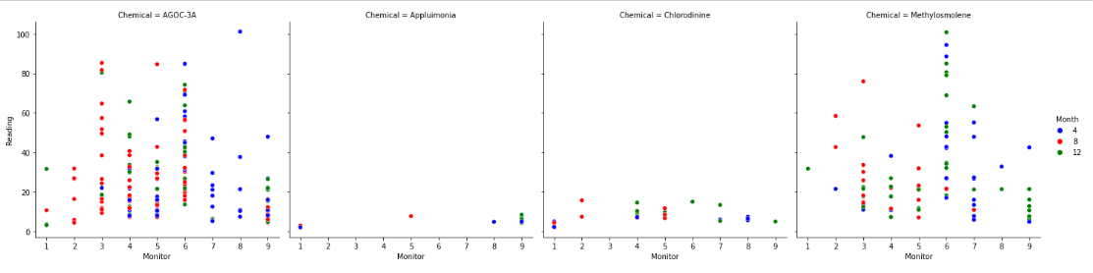
Which chemicals are being detected by the sensor group?
After determining the significance cut-offs, we then extracted the chemicals being detected above the cut-off for each sensor. Also extracted the number of times each chemical was being detected significantly.
Appluimonia is the least detected
AGOC-3A is the most detected
AGOC-3A and Methylosmolene are detected on every sensor
Sensors 6 and 9 have the highest number of times chemicals are detected

Slide 9
What patterns of chemical releases do you see, as being reported in the data?

Slide 10
What patterns of chemical releases do you see, as being reported in the data?

Slide 11
Which factories are responsible for which chemical releases?

Slide 12
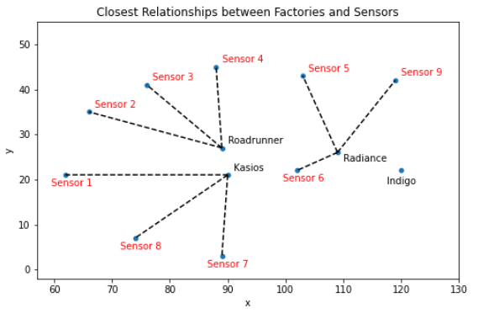
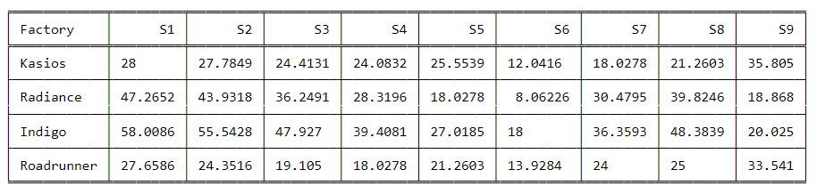
Which factories are responsible for which chemical releases?
Distance Analysis:
Indigo Sol Boards is the furthers away from all sensors except sensor 9, however, it is not the closest factory.

Slide 13
Conclusions
Time Analysis:

